Slide 1

Chief Inspector
Container Damage Inspection powered by Deep Learning

Slide 2
Container Inspection today…
Mostly manual process
Inspection in depots
Expert knowledge needed
Bottleneck process in peak times

Slide 3
Tomorrow / Vision
Detect most important damages automatically based on visual recognition
Early in the process – even at multiple points
Provide assistance for inspectors
Scalability in peak times
Cooperation along the process -> improvement for all

Slide 4
Pitch Solution Architecture

Slide 5
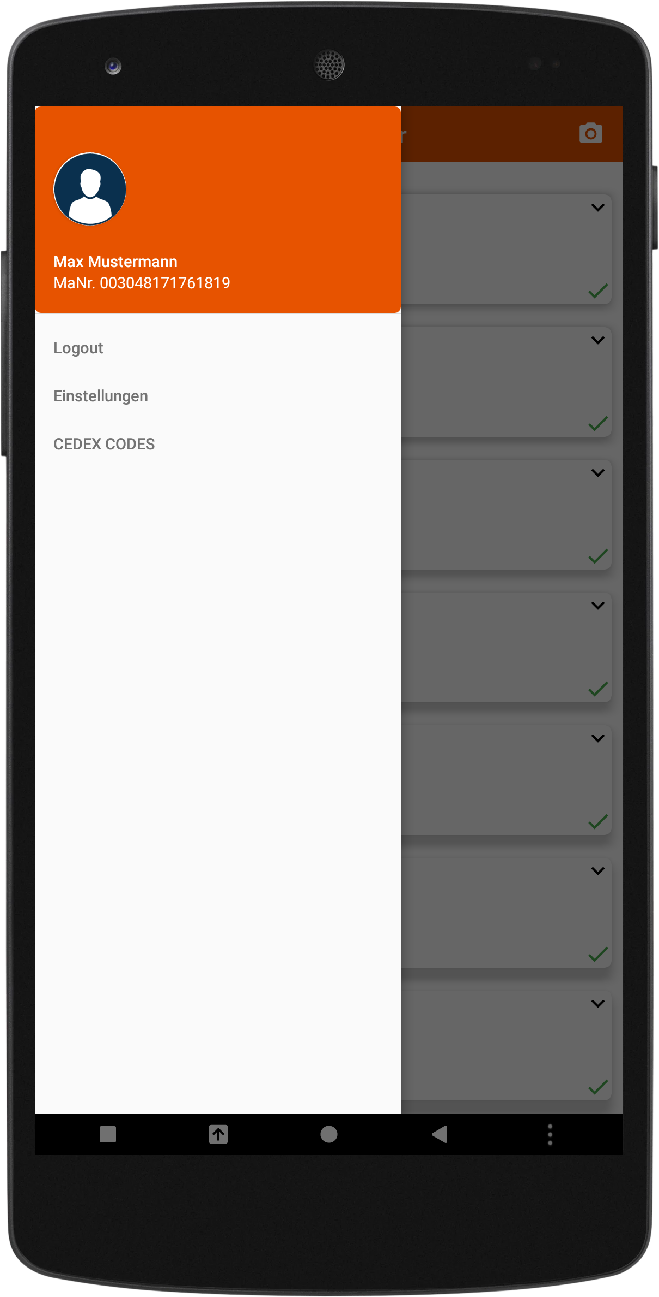
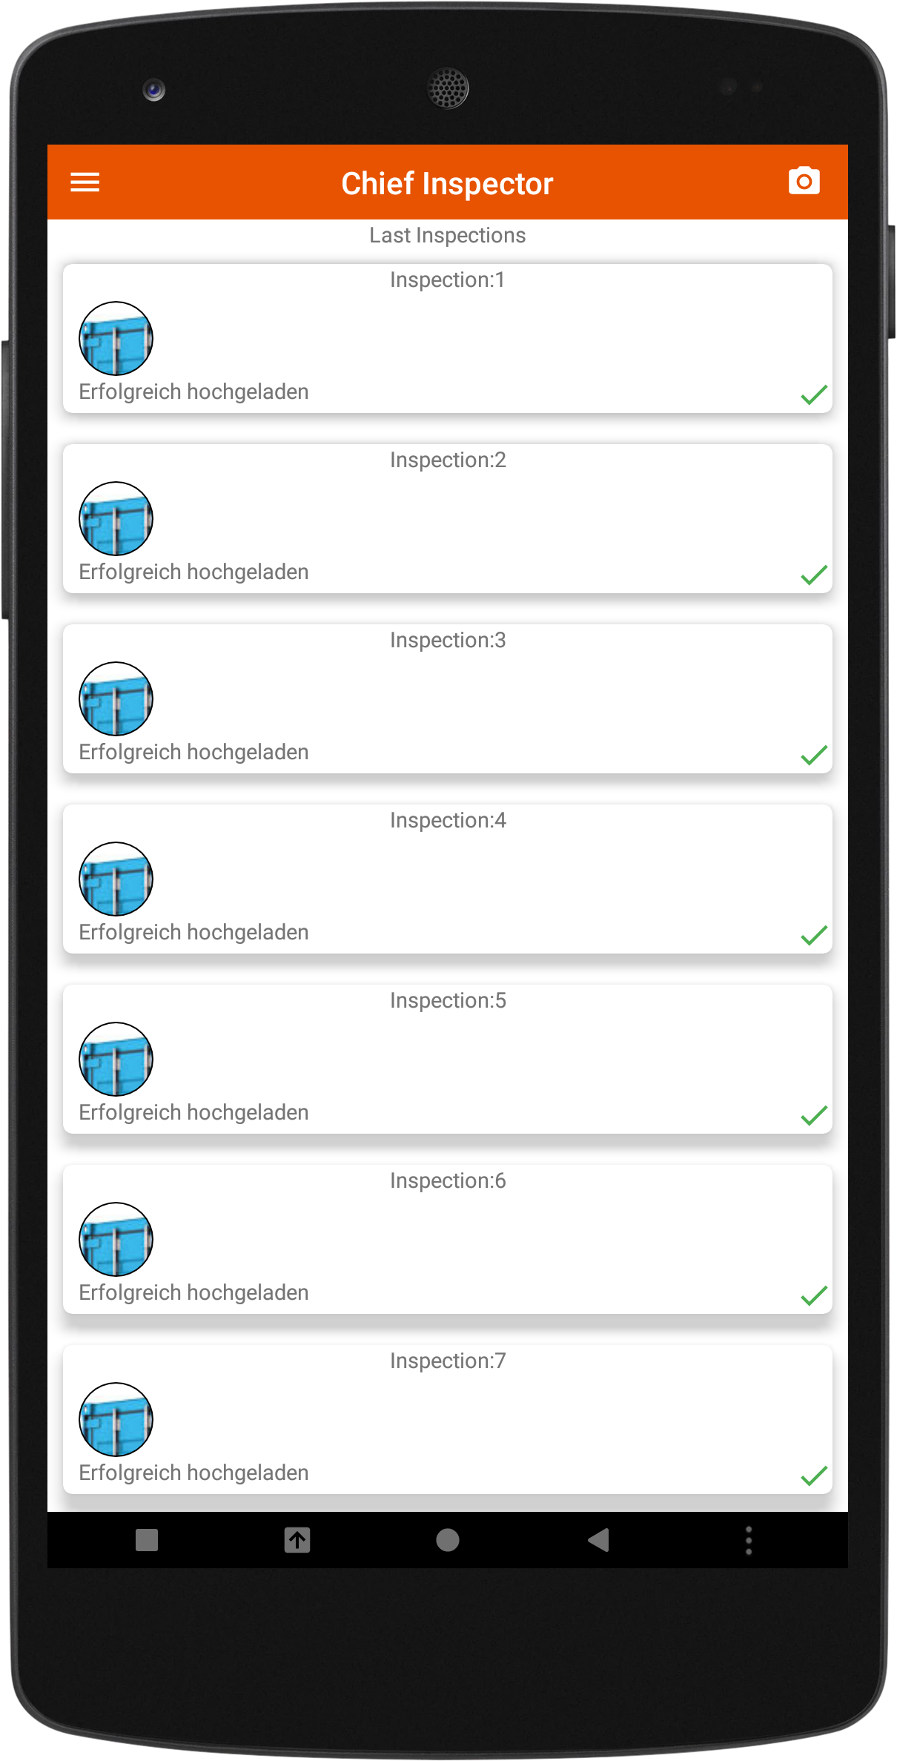
CI App

Slide 6
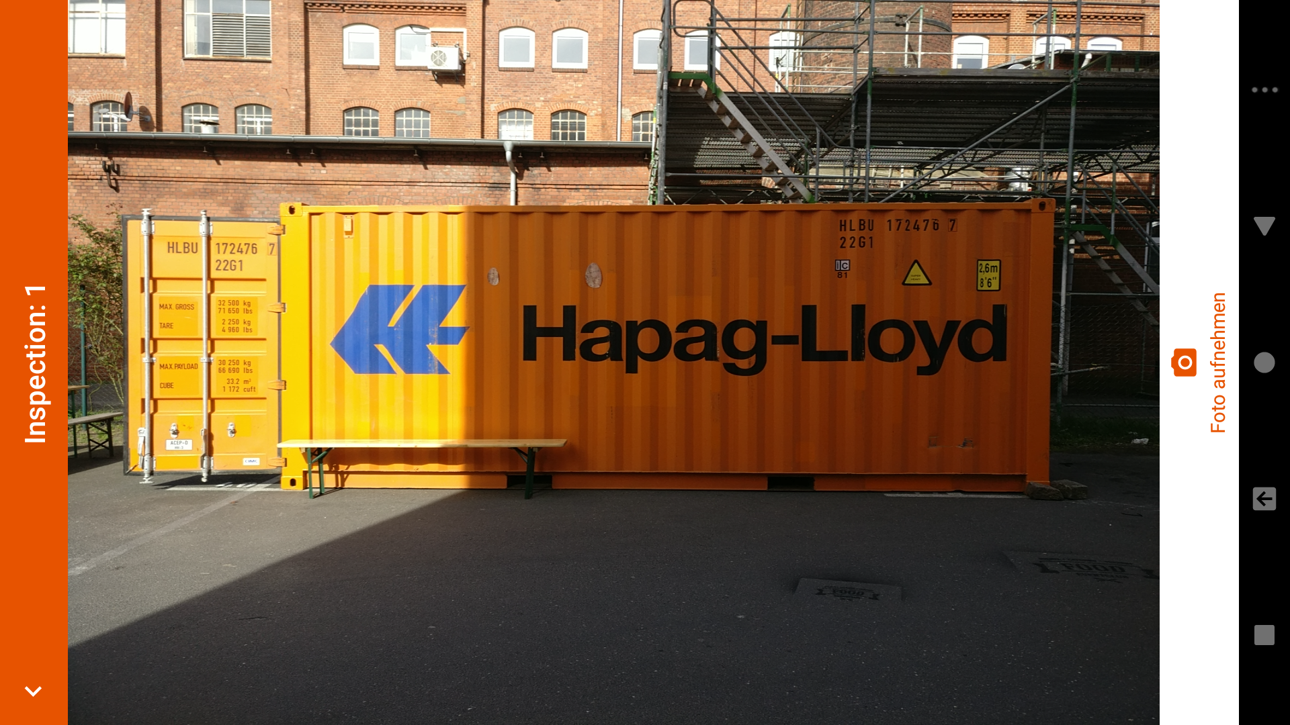
CI App – New Image

Slide 7
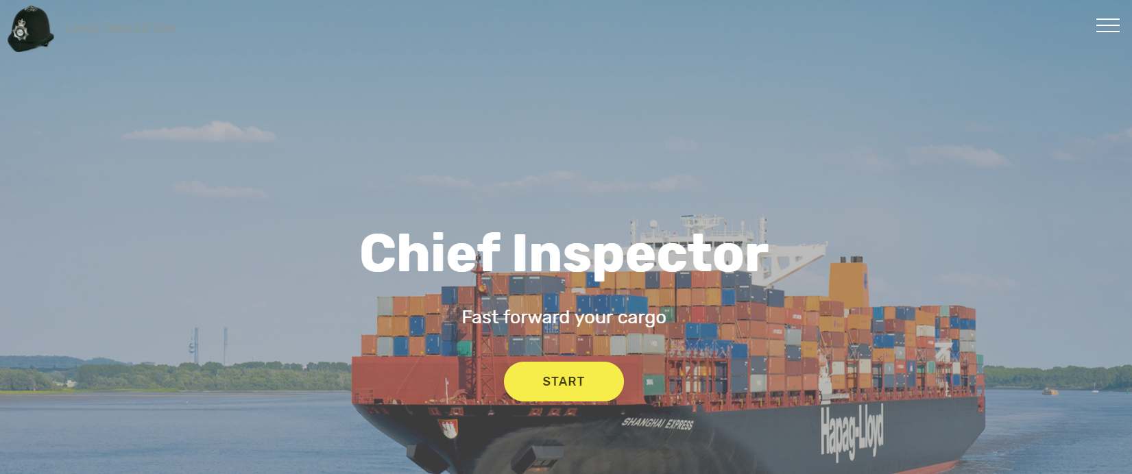
Web App - Home

Slide 8
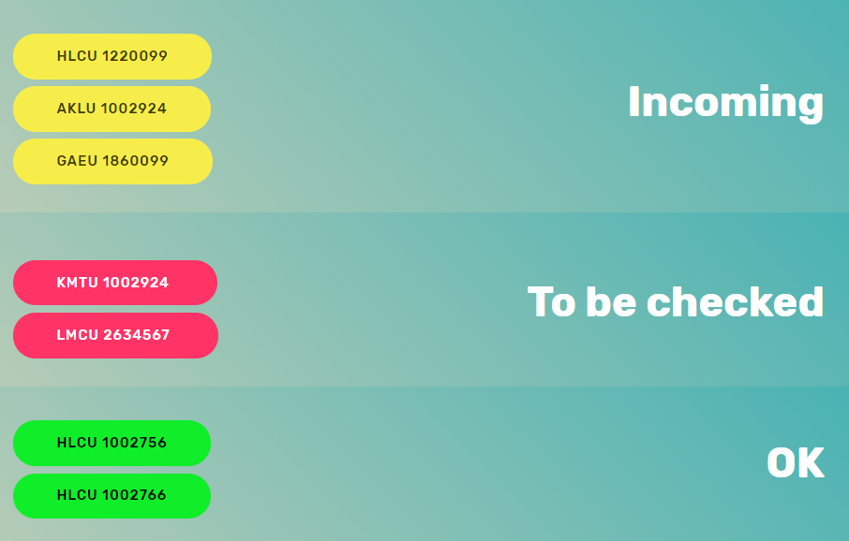
Web App - Dashboard

Slide 9
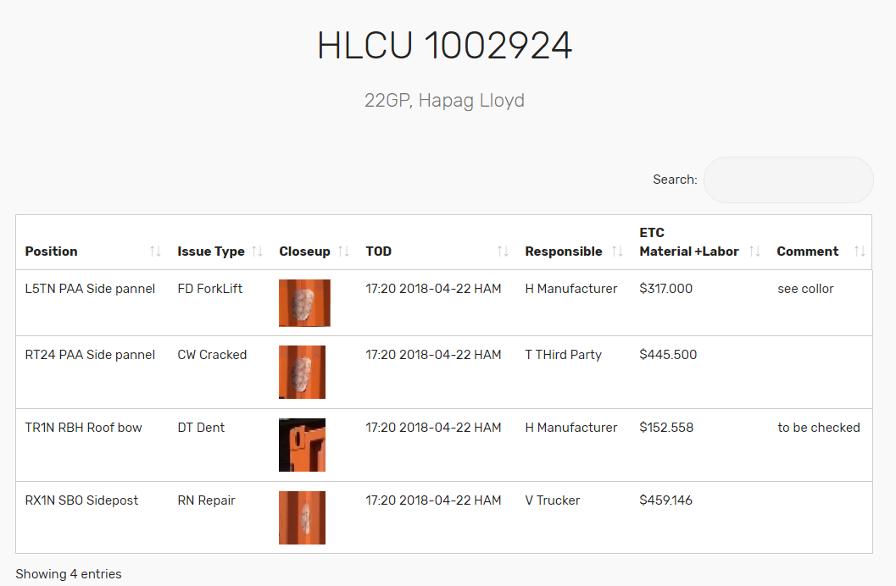
Web App – Inspection List

Slide 10
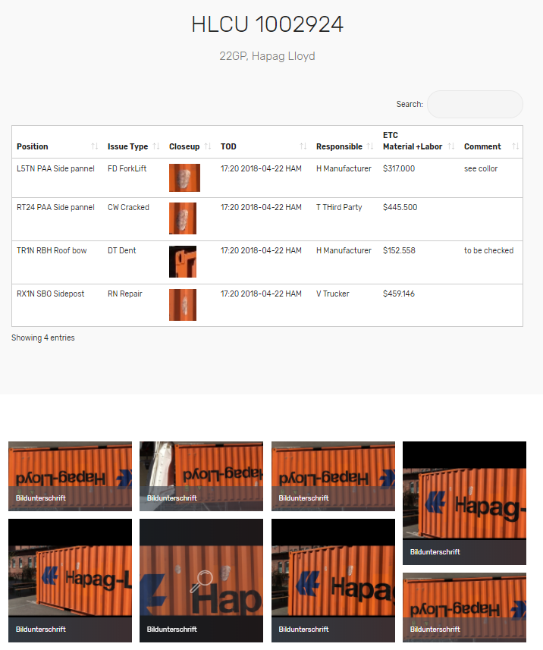
Details

Slide 11
Video examples

Slide 12
Thank you!

